Slide 1

Binary trees: introduction (complete and extended binary trees),
Memory representation (sequential, linked)
Binary tree traversal: pre-order, in-order and post-order (traversal algorithms using stacks)

Slide 2


A tree is a finite set of zero or more nodes
such that:
There is a specially designated node called
the root.
The remaining nodes are partitioned into n>=0 disjoint sets T1, ..., Tn, where each of these sets is a tree.
We call T1, ..., Tn the subtrees of the root.

Slide 3
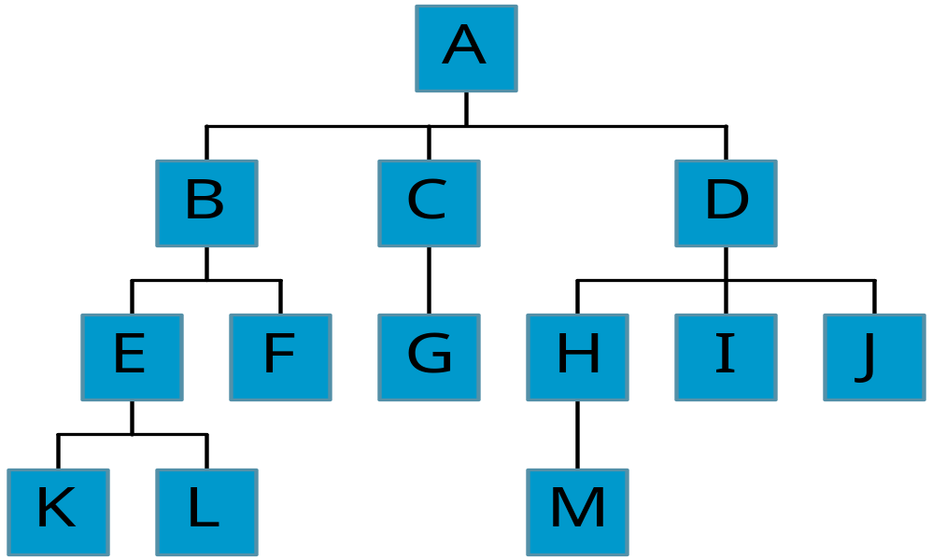
Level and Depth
node (13)
degree of a node(shown by green number)
leaf (terminal)
nonterminal
parent
children
sibling
ancestor
descendant
level of a node
height(depth) of a tree (4)
Level
0
1
2
3
3
2
1
3
2
0
0
1
0
0
0
0
0

Slide 4

Terminology
The degree of a node is the number of subtrees
of the node
  The degree of A is 3; the degree of C is 1.
The node with degree 0 is a leaf or terminal
node.
A node that has subtrees is the parent of the
roots of the subtrees.
The roots of these subtrees are the children of
the node.
Children of the same parent are siblings.
The ancestors of a node are all the nodes
along the path from the root to the node.

Slide 5
Terminology
The depth of a node is the number of edges from the node to the tree’s root node. A root node will have a depth of 0.
The height of a node is the number of edges on the longest path from node to a leaf node. A leaf node will have a height of 0.

Slide 6
Tree Properties
Property Value
Number of nodes 9
Height 5
Root Node A
Leaves 5
Interior nodes A,B,E,G
Number of levels 4
Ancestors of H G,E,B,A
Descendants of B D,E,F,G,H,I
Siblings of E D,F
degree of node A 2
Height of A: 4 and depth of A: 0
A
B
C
D
E
F
G
H
I

Slide 7
Binary Trees
A special class of trees: max degree for each node is 2
Recursive definition: A binary tree is a finite set of nodes that is either empty or consists of a root and two disjoint binary trees called the left subtree and the right subtree.

Slide 8

A
B
E
C
G
D
K
F
H
L
M
I
J

Slide 9
Samples of Trees
A
A
Complete Binary Tree
A
B
B
Skewed Binary Tree
C
B
C
D
D
E
F
G
E
H
I

Slide 10
Maximum Number of Nodes in BT
The maximum number of nodes on level i of a binary tree is 2^{i}, i>=0.
The maximum number of nodes in a binary tree
of depth k is 2^{k}-1, k>=1.

Slide 11
Full BT vs. Complete BT
A full binary tree of depth k is a binary tree of depth k having 2^{k}-1 nodes, k>=1.
A binary tree with n nodes and depth k is
complete iff its nodes correspond to the nodes numbered from 1 to n in the full binary tree of depth k.
A
A
B
C
B
C
D
E
F
G
D
E
F
G
H
H
I
J
K
L
M
N
O
I
Complete binary tree
Full binary tree of depth 4

Slide 12
Complete Binary Tree
If a complete binary tree with n nodes
(depth=└log n + 1┘)
is represented sequentially,
then for any node with index i, 1<=i<=n, we have:
  parent(i) is at └i/2┘ if i!=1. If i=1, i is at the root and
  has no parent.
  leftChild(i) is at 2i if 2i<=n. If 2i>n, then i has no
  left child.
  rightChild(i) is at 2i+1 if 2i+1<=n. If 2i+1>n,
  then i has no right child.

Slide 13
Extended Binary Tree
A binary tree T is said to be a 2-tree or an extended binary tree if each node N has either 0 or 2 children.
The nodes with 2 children are called internal nodes.
The nodes with o children are called external nodes.
A
A
B
C
B
C
D
F
D
F
G
G
Fig: Binary Tree T
Fig: Extended 2-tree

Slide 14
[1]
[2]
[3]
[4]
[5]
[6]
[7]
[8]
[9]
A
B
C
D
E
F
G
H
I
Sequential Representation
[1]
[2]
[3]
[4]
[5]
[6]
[7]
[8]
[9]
.
[16]
A
B
--C
--
--
--
D
--
.
E
(1) waste space
(2) insertion/deletion
problem
A
B
A
C
B
C
D
D
E
F
G
E
H
I

Slide 15
Linked Representation
struct btnode {
int data;
btnode *left, *right;
};
data
left
data
right
left
right

Slide 16

Binary Tree Traversals
There are three standard ways of traversing a binary tree T with root R.
These three algorithms, called:
  preorder
  inorder
  postorder

Slide 17
Arithmetic Expression Using BT
+
preorder traversal
+ * * / A B C D E
prefix expression
inorder traversal
A / B * C * D + E
infix expression
postorder traversal
A B / C * D * E +
postfix expression
*
E
*
D
/
C
A
B

Slide 18
Preorder Traversal (recursive version)
Algorithm:
1. Process the root R.
2. Traverse the left subtree of R in preorder.
3. Traverse the right subtree of R in preorder.
Pseudo-Code:
void preorder(btnode ptr)
/* preorder tree traversal */
{
if (ptr!=NULL) {
cout<<ptr->data;
preorder(ptr->left);
predorder(ptr->right);
}
}
+ * * / A B C D E

Slide 19

Inorder Traversal (recursive version)
Algorithm:
1. Traverse the left subtree of R in inorder.
2. Process the root R.
3. Traverse the right subtree of R in inorder.
Pseudo-Code:
void inorder(btnode ptr)
/* inorder tree traversal */
{
if (ptr!=NULL) {
inorder(ptr->left);
cout<<ptr->data;
indorder(ptr->right);
}
}
A / B * C * D + E

Slide 20
Postorder Traversal (recursive version)
Algorithm:
1. Traverse the left subtree of R in postorder.
2. Traverse the right subtree of R in postorder.
3. Process the root R.
Pseudo-Code:
void postorder(btnode ptr)
/* postorder tree traversal */
{
if (ptr!=NULL) {
postorder(ptr->left);
postorder(ptr->right);
cout<<ptr->data;
}
}
A B / C * D * E +

Slide 21


